Slide 1
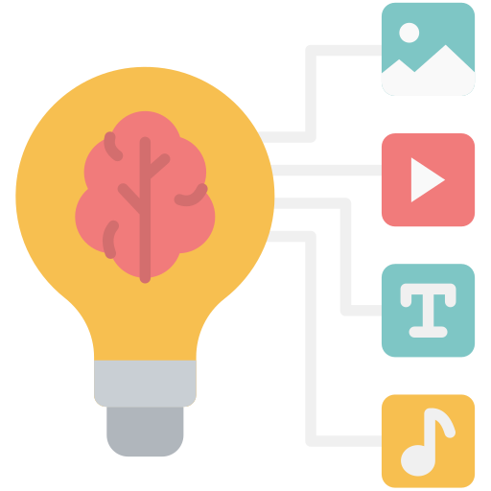

Working with Data and Visualization
Misr International University
AI Summer Camp – Day 2
Day 2

Slide 2
Quick Recap: What did we learn so far?
Misr International University
Variables and Datatypes
Inputs and Outputs
how to store numbers, text, and True/False values
get info from the user and show results with input() and print()
Operators
Conditional Statements
do math and compare values
make decisions with if, elif, and else
Day 2

Slide 3
Quick Recap: What did we learn so far?
Misr International University
Loops and Loop Control
Functions and Methods
repeat actions with for and while
organize code with reusable blocks that can return values
Lists
Dictionaries
store an ordered collection of items to access by position
store key–value pairs for easy lookups and updates
Day 2

Slide 4
Quick Recap: What did we learn so far?
Misr International University
So far, we've written our Python code in single blocks or cells. But real-world programs, especially complex AI projects, are rarely just one giant file. They are often split into multiple, smaller Python files (called modules).
Why is this important for large projects?
Organization: Keeps code tidy and easy to navigate.
Manageability: Easier to work on smaller, focused pieces of code.
Collaboration: Multiple programmers can work on different files simultaneously without conflicts.
Avoiding Overwhelm: Prevents a single file from becoming too long and complex to understand.
Day 2

Slide 5
Quick Recap: What did we learn so far?
Misr International University
Functions: They help us reuse blocks of code within one program.
Remember this function? It takes a number as its input parameter and returns the calculated square result
But what if we need this function across multiple projects or modules? Do we need to constantly write it over and over again?
# Get square of a number (x^2)
def get_square(number):
square = number * number
return square
Day 2

Slide 6
Simple Project Folder Structure
Misr International University
This file contains the main code that starts and controls how your project runs.
Files that store extra functions and helper scripts that make your code cleaner and easier to manage.
This folder holds all the files, like text or images, that your project needs to read or work with.
main.py
tools & utilities/
data/
Day 2

Slide 7
Simple Project Folder Structure
Misr International University
Project/square.py
This file acts as a module within our project. It's a dedicated place to store a specific, reusable function: get_square().
def get_square(number):
square = number * number
return square
Project/main.py
This is our main program file. Instead of redefining get_square(), we use the import statement to bring it in from our square.py module.
from square import get_square get_square(4)
# output is 4^2 = 16
Day 2

Slide 8
What’s an import?
Misr International University
In Python, the import statement is like building a bridge between different parts of your code. It allows you to bring code (functions, variables, classes) from one Python file (called a module) into another file where you want to use it.
Imports keep your projects organized, DRY (Don’t Repeat Yourself), and easy to grow.
Libraries
Custom Files
unlock powerful ready-made tools written by others without dealing with their internal implementation
reuse your own functions and code saved in other Python files
Day 2

Slide 9
Examples of common libraries
Misr International University
Python Standard Libraries
PyPI Third Party Libraries
These are essential collections of code that come built-in with Python. You don't need to install them separately; they're ready to import and use right away! They provide common functionalities for everyday programming tasks.
math: For mathematical operations
random: For generating random numbers
datetime: For working with dates and times.
os: For interacting with your computer's operating system (files and folders)
These are powerful libraries developed by the global Python community. They are not built-in and need to be installed (usually via pip from PyPI, the Python Package Index, like an app store for Python code).
NumPy: For incredibly fast numerical computations and working with arrays
Pandas: For organizing, cleaning, and manipulating tabular data (like spreadsheets).
Matplotlib: For creating professional data visualizations (charts, graphs).
Day 2

Slide 10
Misr International University
Why do we use libraries?
Libraries contain highly optimized, pre-written code that can replace many lines of manual programming with just one powerful function call. This saves time and reduces errors!
Without libraires Vs
with libraries
scores = [85, 92, 78, ..., 91]
# Imagine a very long list with 1000 scores!
total_sum = 0
count = 0
for score in scores:
total_sum += score
count += 1
average = total_sum / count
print(f"Average score is {average}")
# Many lines of code just for average!
import numpy as np
# Bring in the NumPy toolbox
scores = np.array([85, 92, 78, ..., 91])
average = np.mean(scores)
# One simple line!
print(f"Average score is {average}")
Day 2

Slide 11

Misr International University
Now let’s continue on over colab
Day 2

